Slide 1



Linear regression
La Serena Data Science School
Matthew J. Graham Center for Data-Driven Discovery/ZTF, Caltech
mjg@caltech.edu
(with material from Pavlos Protopapas and Guillermo Cabrera)
August 21, 2017

Slide 2
Outline
Statistical Modelling
Error and Loss Functions
Evaluating Model Performance
Linear Regression
Multiple Linear Regression (with interaction terms)
Polynomial Regression
Robust Regression
Model Selection
Regularization
Heteroscedastic Errors

Slide 3
Predicting a variable
Let’s imagine a scenario where we’d like to predict one variable using another (or a set of other) variables:
Examples:
Predicting the amount of views a YouTube video will get next week based on video length, the date it was posted, previous number of views, etc.
Predicting which movies a Netflix user will rate highly based on their previous movie ratings, demographic data, etc.
Predicting the expected cab fare in New York City based on time of year, location of pickup, weather conditions, etc.
Predicting the redshift of a galaxy based on its magnitudes and colors in different passband filters

Slide 4
Outcome vs. predictor values
Definition
Suppose we are observing p+1 number variables and we are making n sets of observations. We call:
the variable we’d like to predict the outcome or response variable; typically, we denote this variable by Y and the individual measurements y_{i}
the variables we use in making the predictions the features or predictor variables; typically, we denote these variables by X = (X₁,…,X_{p}) and the individual measurements x_{i,j}.
Note: i indexes the observation (i=1,2,…,n) and j indexes the value of the j-th predictor variable (j=1,2,…,p)

Slide 5
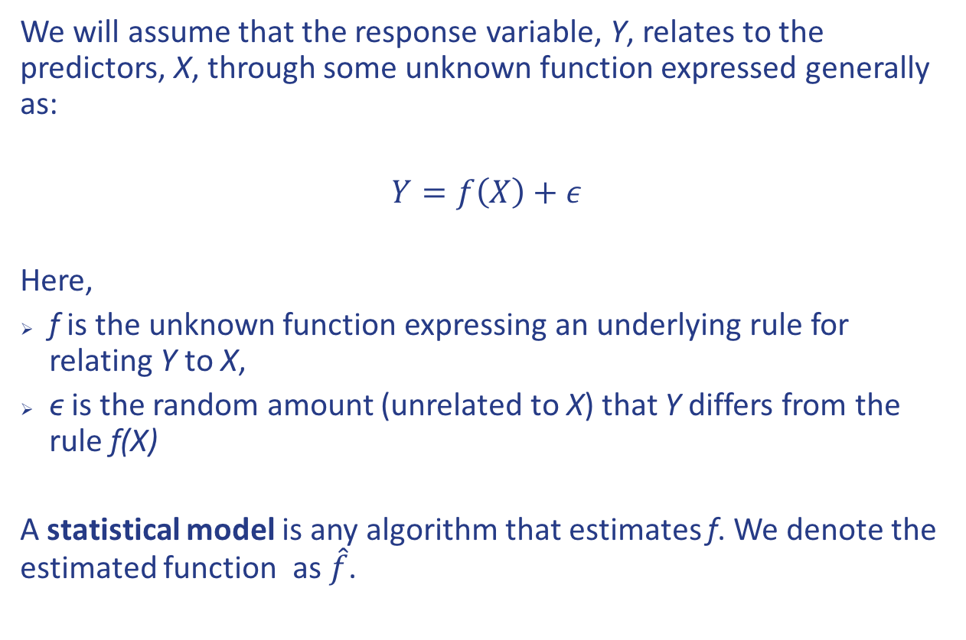
True vs. statistical model
We will assume that the response variable, Y, relates to the predictors, X, through some unknown function expressed generally as:
$Y=f\left(X\right)+ε$
Here,
f is the unknown function expressing an underlying rule for relating Y to X,
ϵ is the random amount (unrelated to X) that Y differs from the rule f(X)
A statistical model is any algorithm that estimates f. We denote the estimated function as $\hat{f}$.

Slide 6
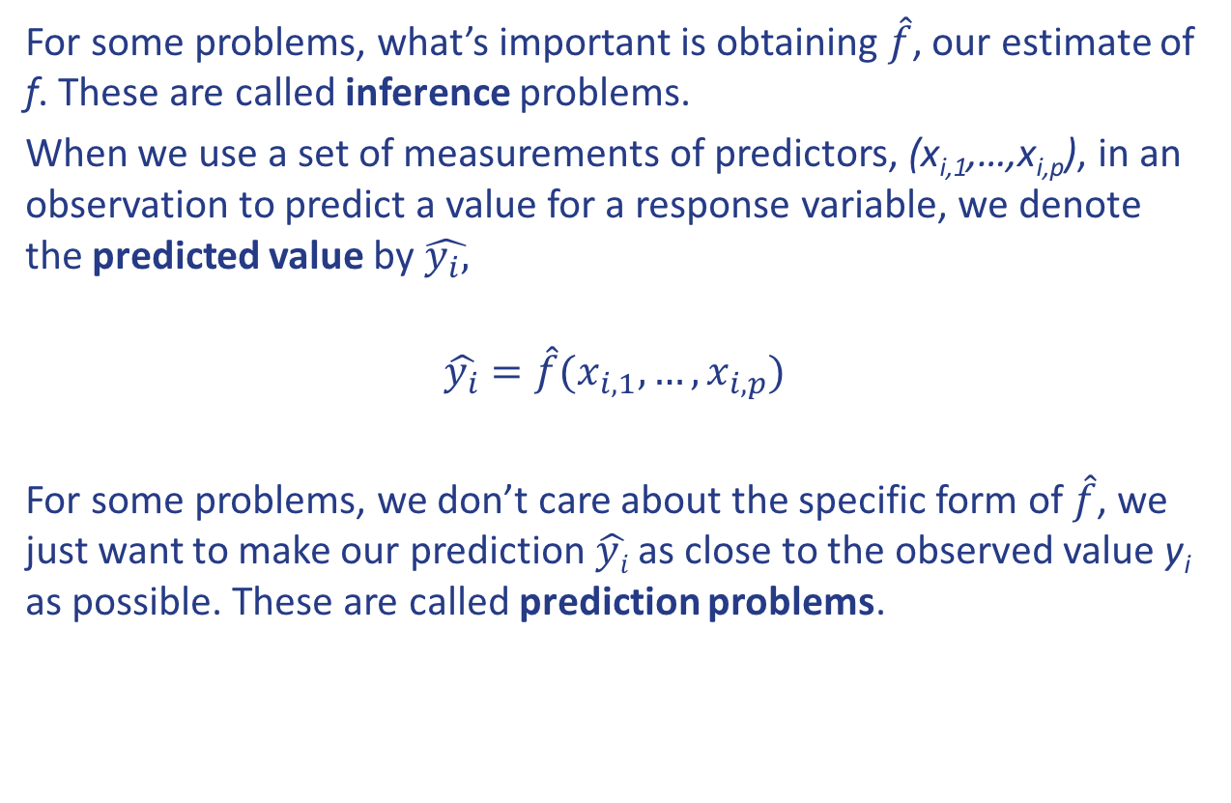
Prediction vs. estimation
For some problems, what’s important is obtaining $\hat{f}$, our estimate of f. These are called inference problems.
When we use a set of measurements of predictors, (x_{i,1},…,x_{i,p}), in an observation to predict a value for a response variable, we denote the predicted value by $\hat{y_{i},}$
$$\hat{y_{i}}=\hat{f}(x_{i,1},…,x_{i,p})$$
For some problems, we don’t care about the specific form of $\hat{f}$, we just want to make our prediction $\hat{yi}$ as close to the observed value y_{i} as possible. These are called prediction problems.

Slide 7
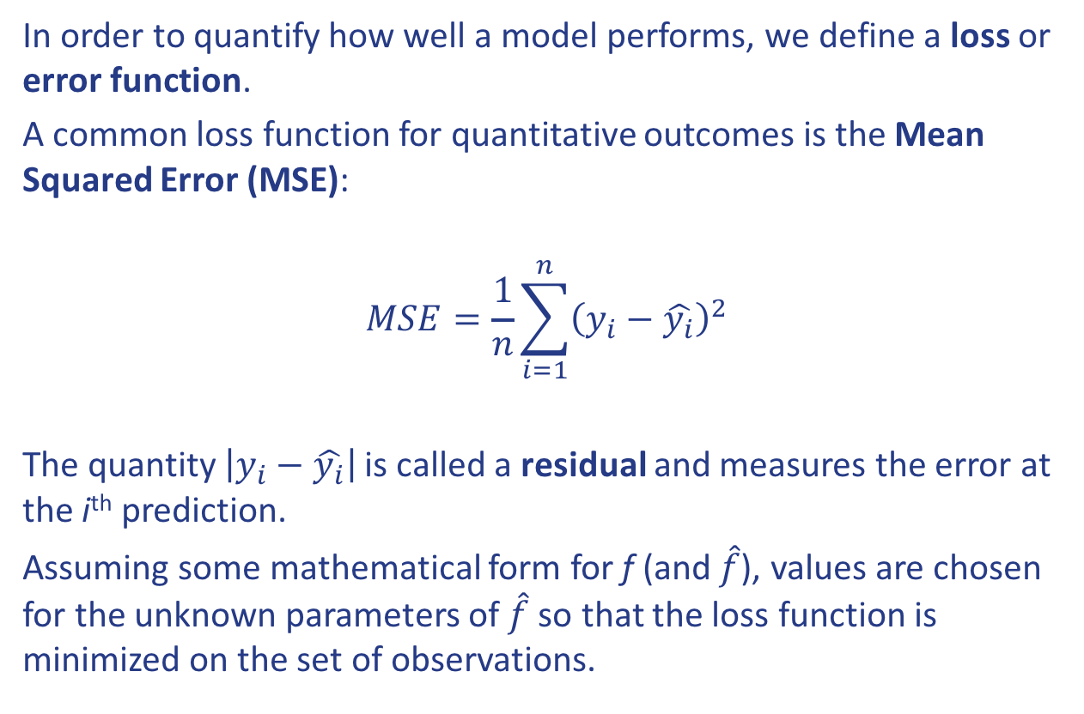
Error and loss functions
In order to quantify how well a model performs, we define a loss or error function.
A common loss function for quantitative outcomes is the Mean Squared Error (MSE):
$$MSE=\frac{1}{n}\sum_{i=1}^{n}{{\left(y_{i}−\hat{y_{i}}\right)}^{2}}$$
The quantity $\left|y_{i}−\hat{y_{i}}\right|$ is called a residual and measures the error at the i^{th} prediction.
Assuming some mathematical form for f (and $\hat{f}$), values are chosen for the unknown parameters of $\hat{f}$ so that the loss function is minimized on the set of observations.

Slide 8
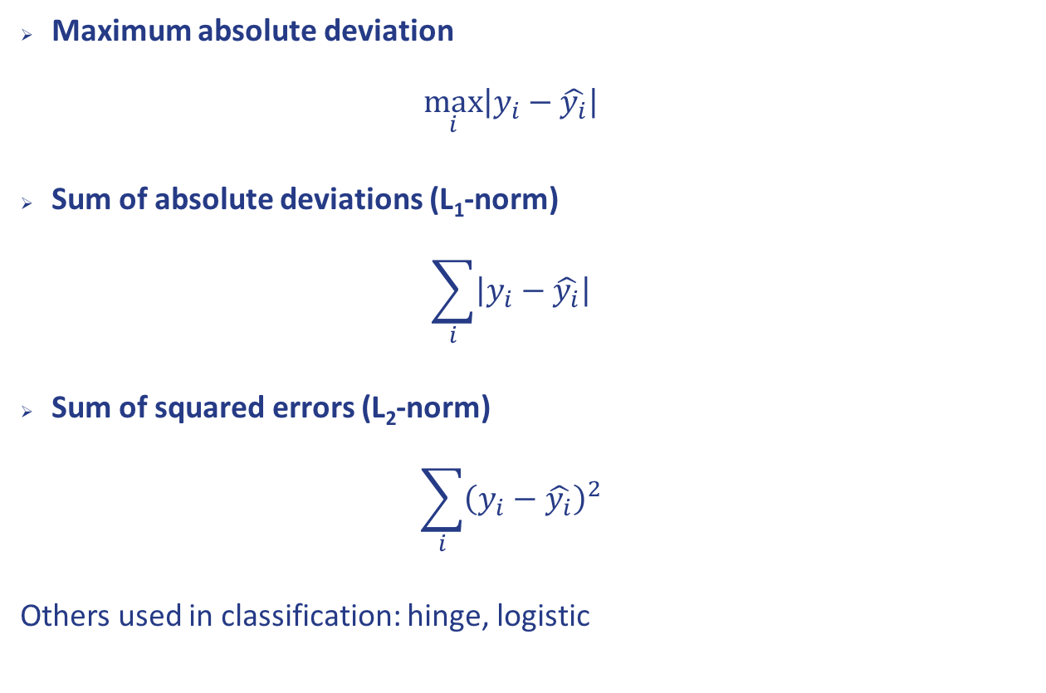
Other loss functions
Maximum absolute deviation $\max_{i}\left|y_{i}−\hat{y_{i}}\right|$
Sum of absolute deviations (L₁-norm) $\sum_{i}{\left|y_{i}−\hat{y_{i}}\right|}$
Sum of squared errors (L₂-norm) $\sum_{i}{{\left(y_{i}−\hat{y_{i}}\right)}^{2}}$
Others used in classification: hinge, logistic

Slide 9
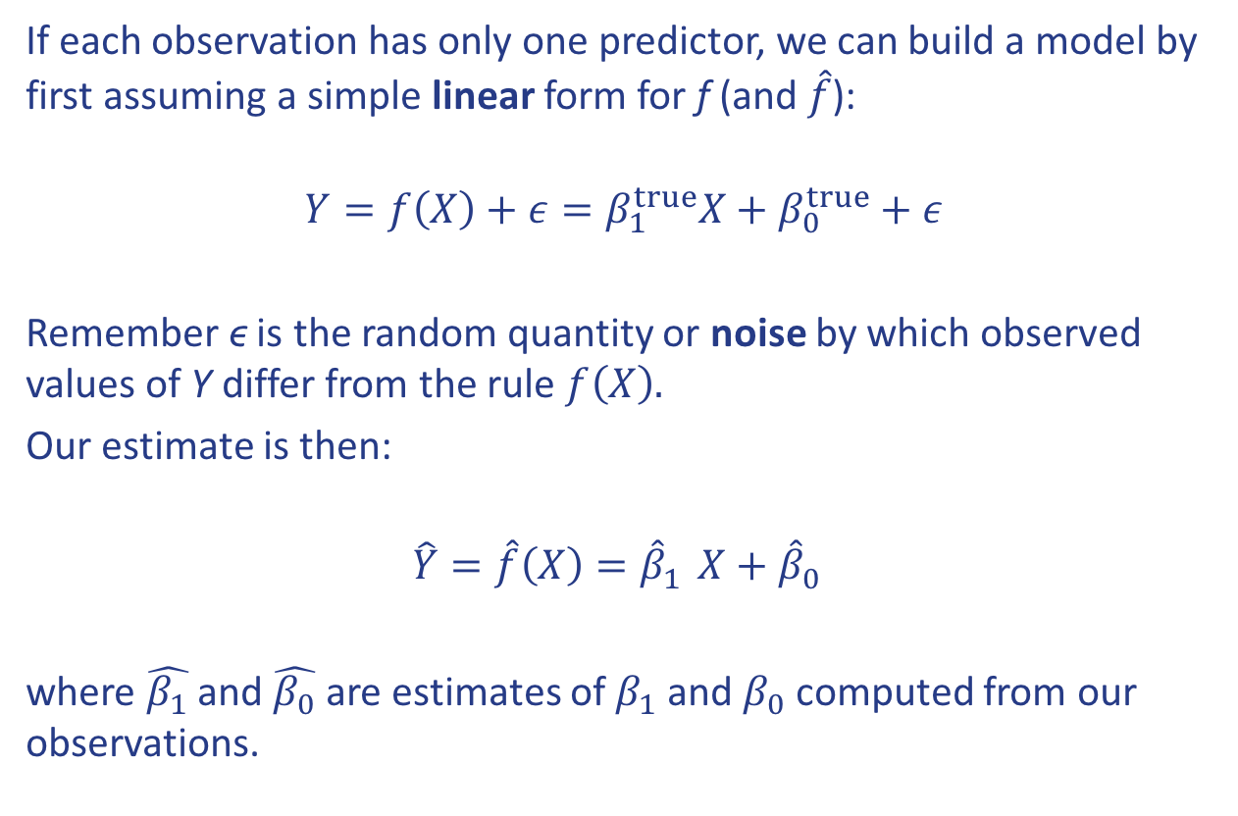
Linear regression
If each observation has only one predictor, we can build a model by first assuming a simple linear form for f (and $\hat{f}$):
$$Y=f\left(X\right)+ε=β_{1}^{true}X+β_{0}^{true}+ε$$
Remember ϵ is the random quantity or noise by which observed values of Y differ from the rule $f\left(X\right).$
Our estimate is then:
$$\hat{Y}=\hat{f}\left(X\right)={\hat{β}}_{1}^{}X+{\hat{β}}_{0}^{}$$
where $\hat{β_{1}}$ and $\hat{β_{0}}$ are estimates of $β_{1}$ and $β_{0}$ computed from our observations.

Slide 10
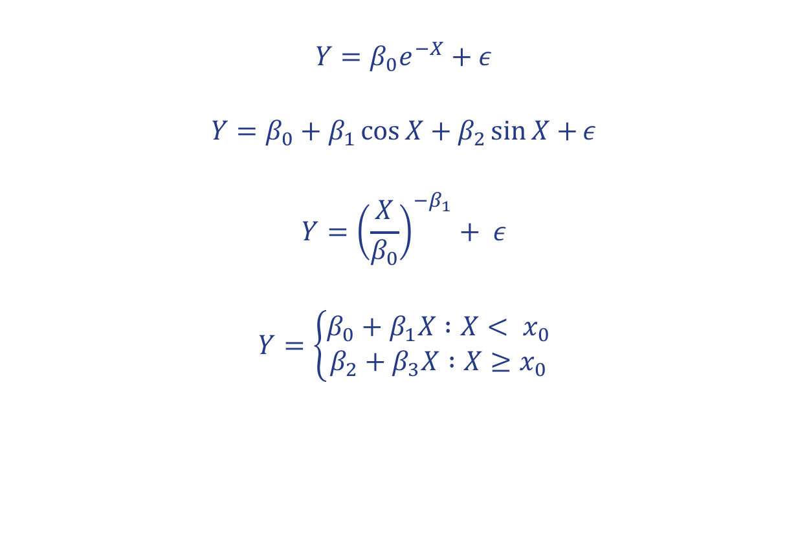
Which models are linear?
$$Y=β_{0}e^{−X}+ε$$
$$Y=β_{0}+β_{1}\cos{X+β_{2}\sin{X}+}ε$$
$$Y={\left(\frac{X}{β_{0}}\right)}^{−β_{1}}+ ε$$
$$Y=\left\{\begin{aligned}β_{0}+β_{1}X :X< x_{0} \\ β_{2}+β_{3}X :X≥x_{0}\end{aligned}\right.$$

Slide 11
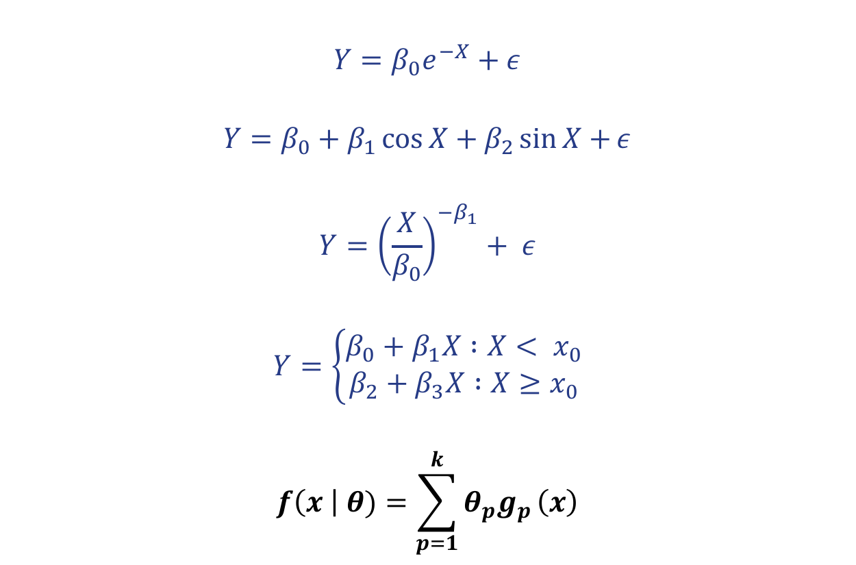
Which models are linear?
$$Y=β_{0}e^{−X}+ε$$
$$Y=β_{0}+β_{1}\cos{X+β_{2}\sin{X}+}ε$$
$$Y={\left(\frac{X}{β_{0}}\right)}^{−β_{1}}+ ε$$
$$Y=\left\{\begin{aligned}β_{0}+β_{1}X :X< x_{0} \\ β_{2}+β_{3}X :X≥x_{0}\end{aligned}\right.$$
$$f\left(x \right| θ)=\sum_{p=1}^{k}{θ_{p}g_{p}}\left(x\right)$$
YES
YES
NO
NO

Slide 12
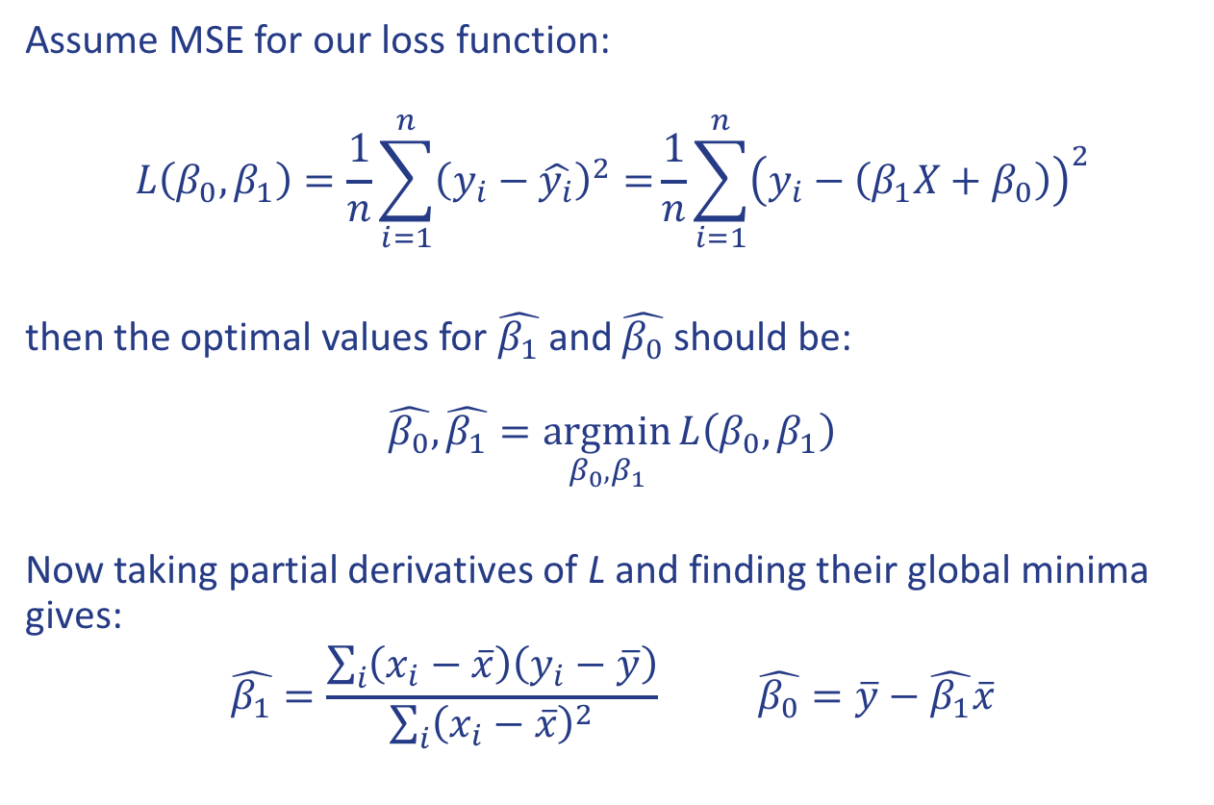
Inference for linear regression
Assume MSE for our loss function:
$$L\left(β_{0},β_{1}\right)=\frac{1}{n}\sum_{i=1}^{n}{{\left(y_{i}−\hat{y_{i}}\right)}^{2}=}\frac{1}{n}\sum_{i=1}^{n}{{\left(y_{i}−\left(β_{1}X+β_{0}\right)\right)}^{2}}$$
then the optimal values for $\hat{β_{1}}$ and $\hat{β_{0}}$ should be: $$\hat{β_{0}},\hat{β_{1}}=\underset{β_{0},β_{1}}{argmin}{L\left(β_{0},β_{1}\right)}$$
Now taking partial derivatives of L and finding their global minima gives:
$$\hat{β_{1}}=\frac{\sum_{i}{\left(x_{i}−\overline{x}\right)\left(y_{i}−\overline{y}\right)}}{\sum_{i}{{\left(x_{i}−\overline{x}\right)}^{2}}} \hat{β_{0}}=\overline{y}−\hat{β_{1}}\overline{x}$$

Slide 13
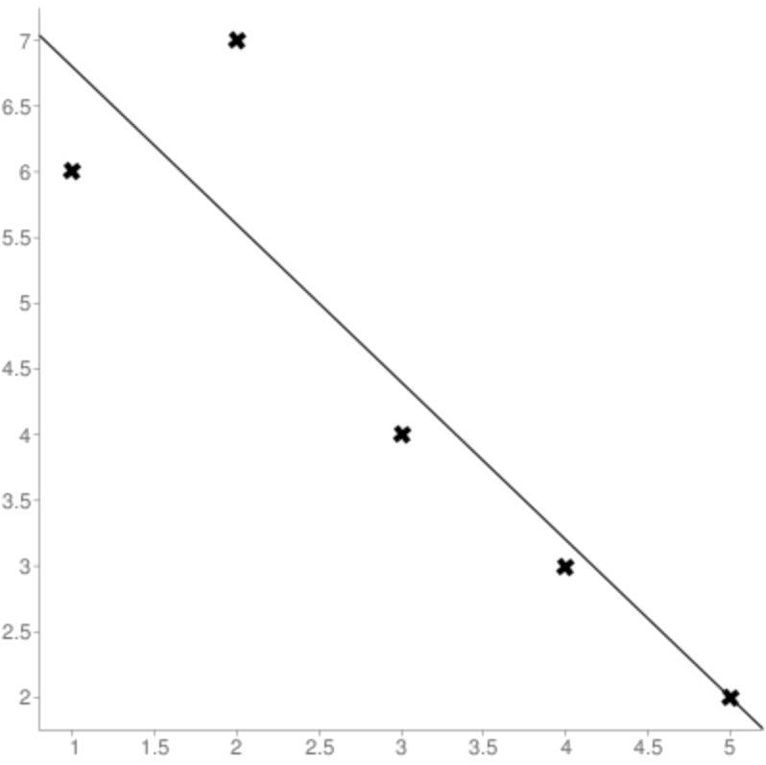
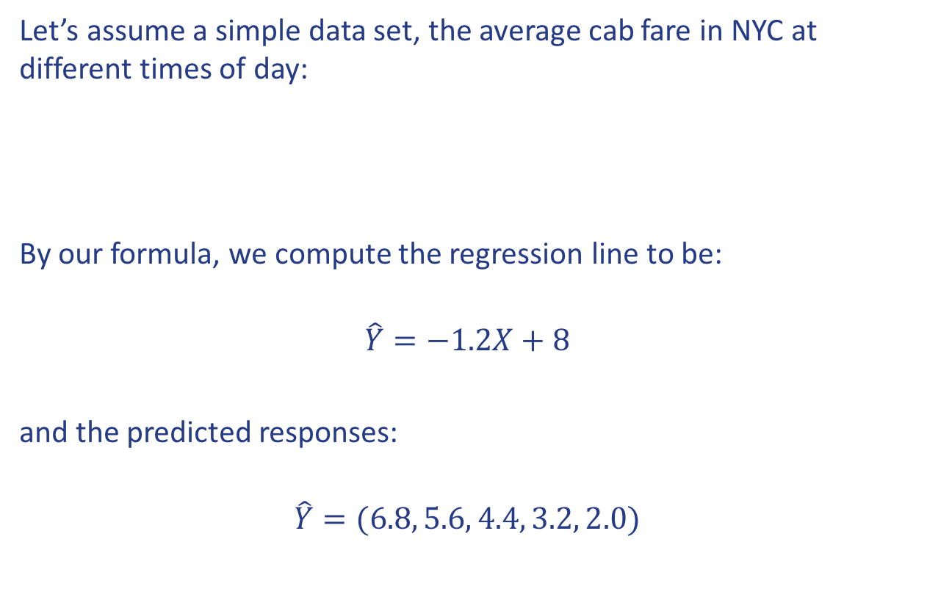
Linear regression: a simple example
Let’s assume a simple data set, the average cab fare in NYC at different times of day:
By our formula, we compute the regression line to be:
$$\hat{Y}=−1.2X+8$$
and the predicted responses:
$$\hat{Y}=(6.8, 5.6, 4.4, 3.2, 2.0)$$
Time (X) | 1 | 2 | 3 | 4 | 5
Fare (Y) | 6 | 7 | 4 | 3 | 2

Slide 14
Training vs. Testing Sets
One way to evaluate our model is to use it to predict the responses for predictors that we did not use to build our model. This involves splitting data into a training set and a testing set after collecting a set of observations of predictor and response.
We use the training set to build a model and use the testing set to perform a final evaluation of the model, simulating model performance in real-time usage.
Note: To maintain the integrity of the final test, the test data should only be used once and the results should not be used to inform changes made to the model.

Slide 15
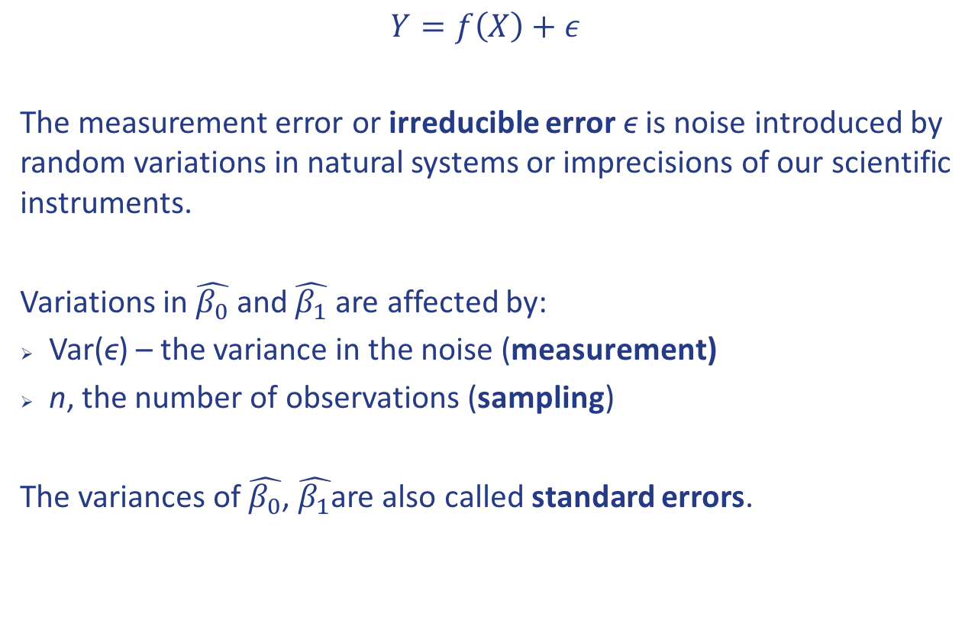
Measurement vs. sampling error
$Y=f\left(X\right)+ε$
The measurement error or irreducible error ϵ is noise introduced by random variations in natural systems or imprecisions of our scientific instruments.
Variations in $\hat{β_{0}}$ and $\hat{β_{1}}$ are affected by:
Var(ϵ) – the variance in the noise (measurement)
n, the number of observations (sampling)
The variances of $\hat{β_{0}}$, $\hat{β_{1}}$are also called standard errors.

Slide 16
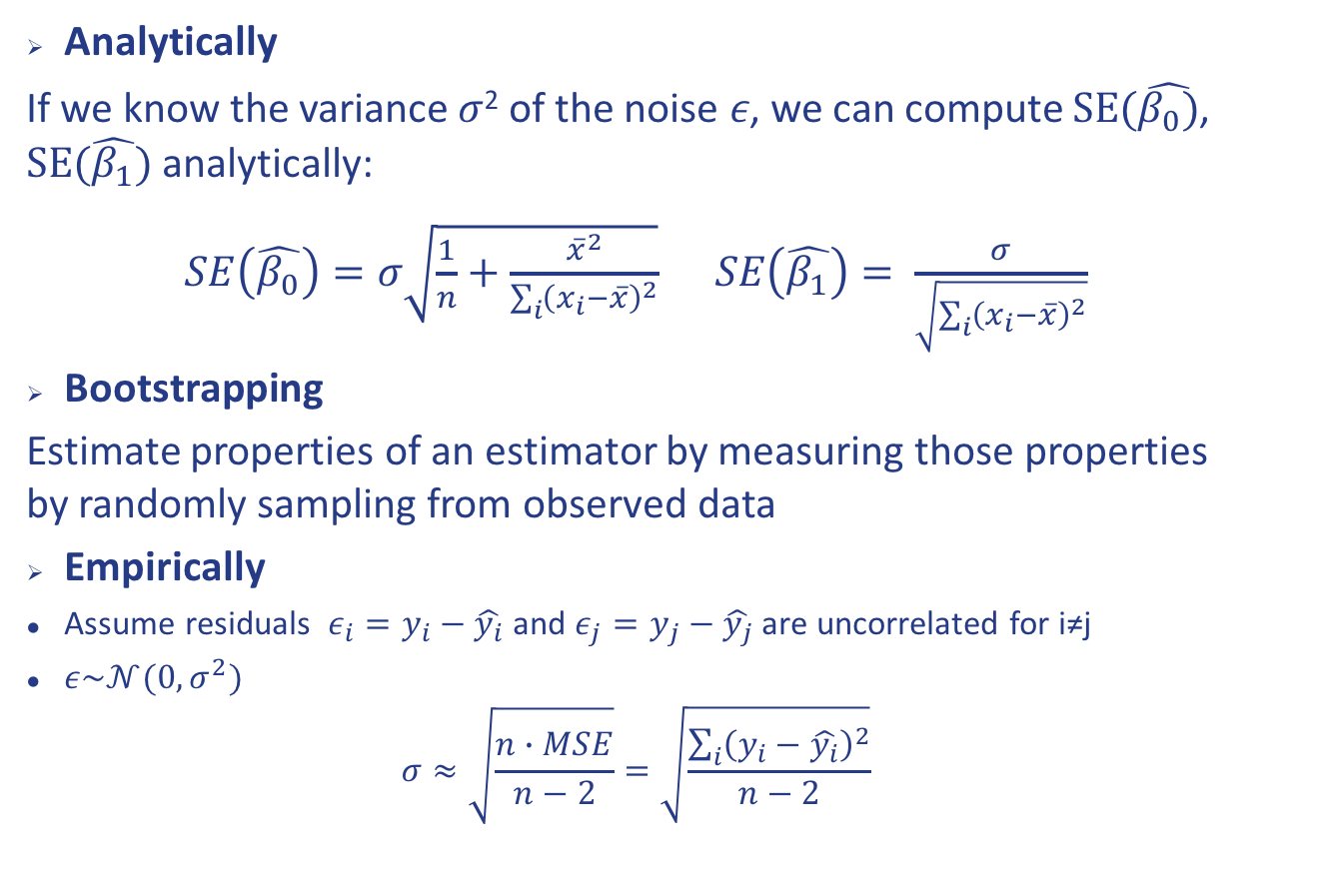
Estimating sampling errors
Analytically
If we know the variance 𝜎² of the noise 𝜖, we can compute $SE(\hat{β_{0})}$, $SE(\hat{β_{1}})$ analytically:
$SE\left(\hat{β_{0}}\right)=σ\sqrt{\frac{1}{n}+\frac{{\overline{x}}^{2}}{\sum_{i}{{\left(x_{i}−\overline{x}\right)}^{2}}}} SE\left(\hat{β_{1}}\right)= \frac{σ}{\sqrt{\sum_{i}{{\left(x_{i}−\overline{x}\right)}^{2}}}}$
Bootstrapping
Estimate properties of an estimator by measuring those properties by randomly sampling from observed data
Empirically
Assume residuals $ε_{i}=y_{i}−\hat{y_{i}}$ and $ε_{j}=y_{j}−\hat{y_{j}}$ are uncorrelated for i≠j
$ε\sim 𝒩(0,σ^{2})$
$$σ≈\sqrt{\frac{n∙MSE}{n−2}}=\sqrt{\frac{\sum_{i}{{\left(y_{i}−\hat{y_{i}}\right)}^{2}}}{n−2}}$$

Slide 17
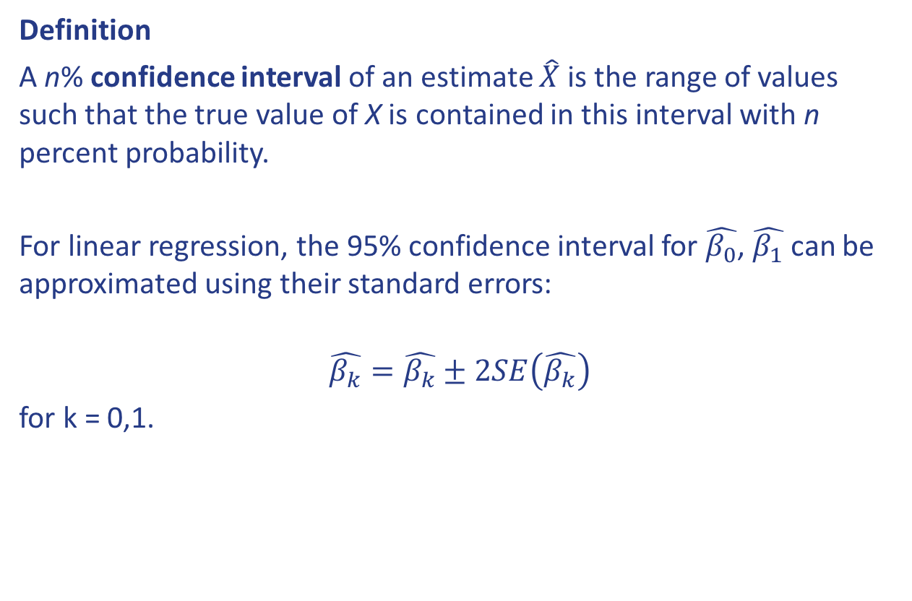
Confidence intervals
Definition
A n% confidence interval of an estimate $\hat{X}$ is the range of values such that the true value of X is contained in this interval with n percent probability.
For linear regression, the 95% confidence interval for $\hat{β_{0}}$, $\hat{β_{1}}$ can be approximated using their standard errors:
$$\hat{β_{k}}=\hat{β_{k}}±2SE\left(\hat{β_{k}}\right)$$
for k = 0,1.

Slide 18
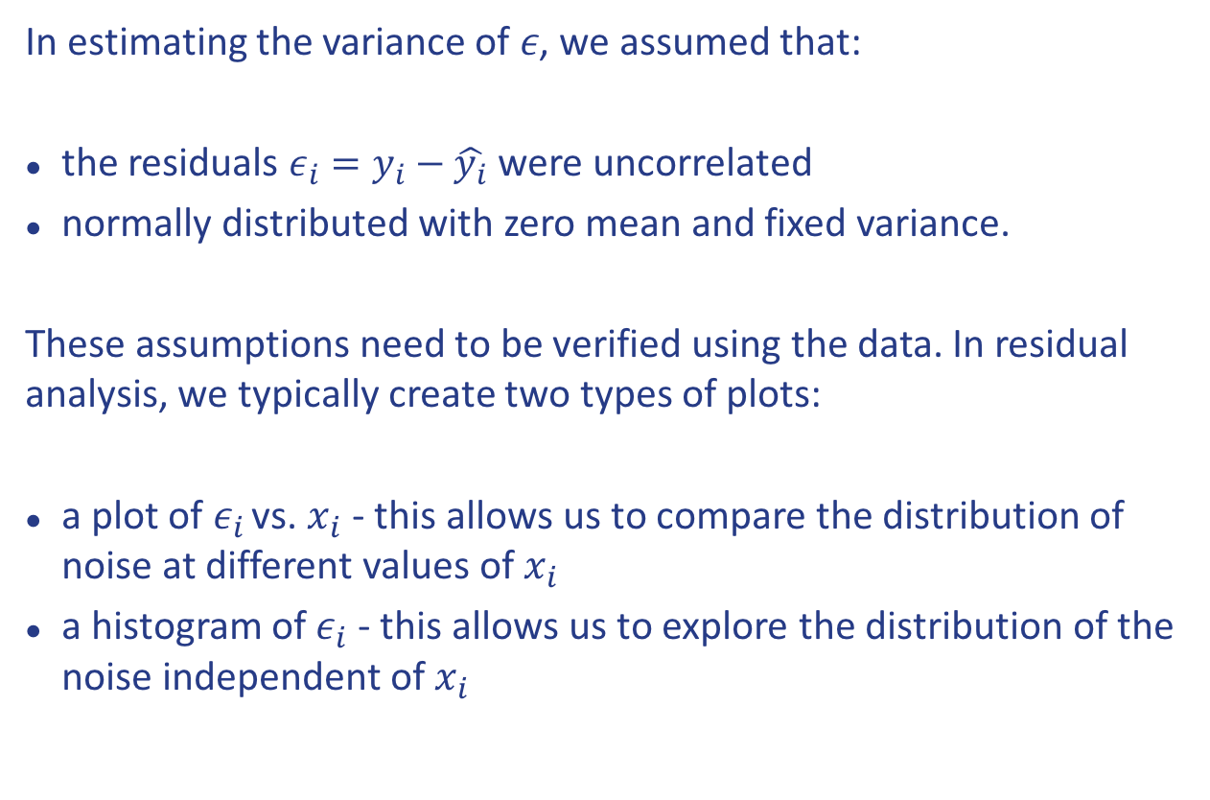
Residual analysis
In estimating the variance of 𝜖, we assumed that:
the residuals $ε_{i}=y_{i}−\hat{y_{i}}$ were uncorrelated
normally distributed with zero mean and fixed variance.
These assumptions need to be verified using the data. In residual analysis, we typically create two types of plots:
a plot of $ε_{i}$ vs. $x_{i}$ - this allows us to compare the distribution of noise at different values of $x_{i}$
a histogram of $ε_{i}$ - this allows us to explore the distribution of the noise independent of $x_{i}$

Slide 19

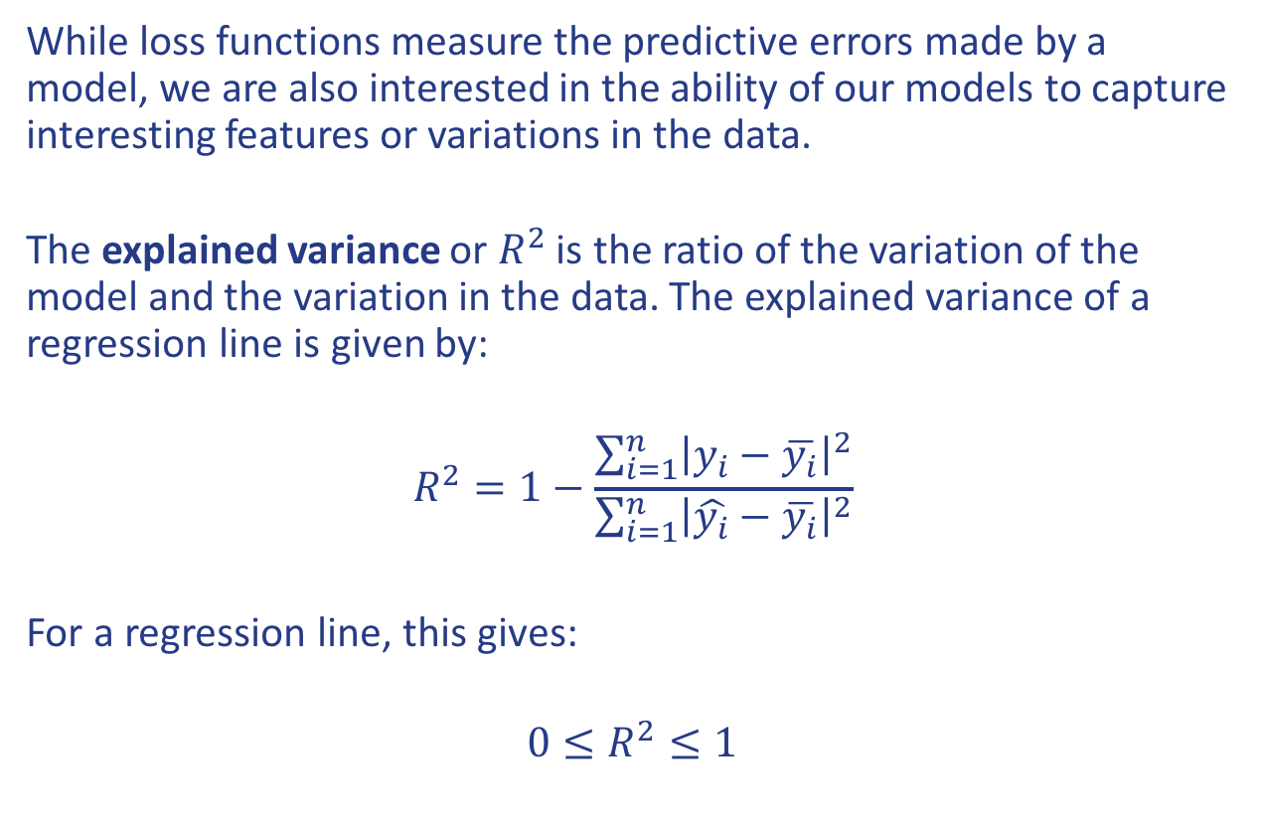
Model fitness: $R^{2}$
While loss functions measure the predictive errors made by a model, we are also interested in the ability of our models to capture interesting features or variations in the data.
The explained variance or $R^{2}$ is the ratio of the variation of the model and the variation in the data. The explained variance of a regression line is given by:
$$R^{2}=1−\frac{\sum_{i=1}^{n}{{\left|y_{i}−\overline{y_{i}}\right|}^{2}}}{\sum_{i=1}^{n}{{\left|\hat{y_{i}}−\overline{y_{i}}\right|}^{2}}}$$
For a regression line, this gives:
$$0≤R^{2}≤1$$

Slide 20
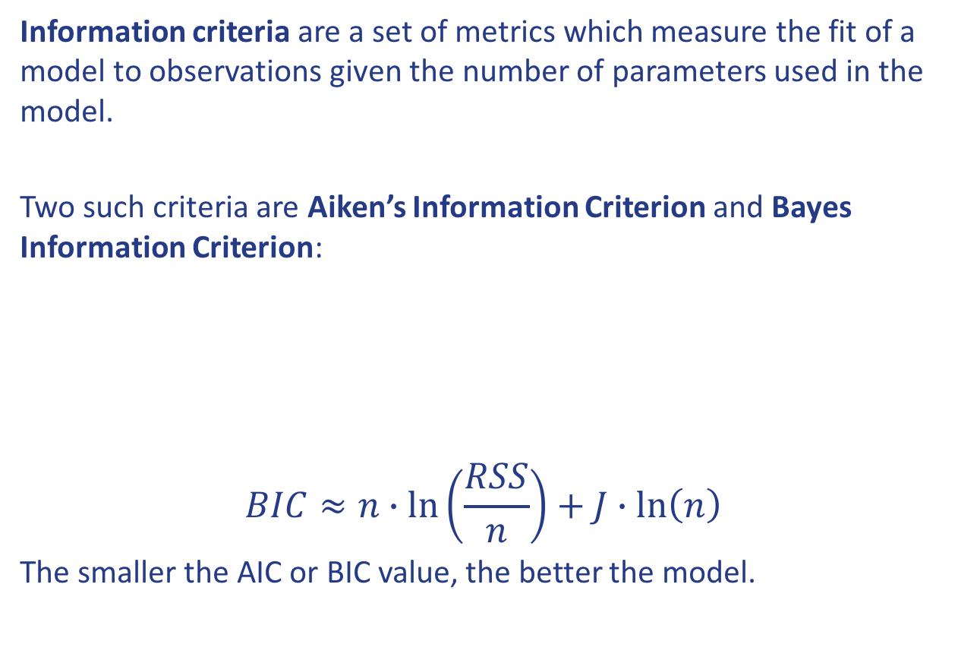
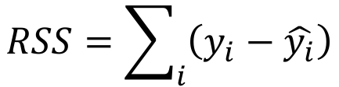
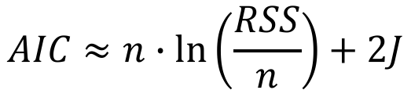
Model fitness: information criteria
Information criteria are a set of metrics which measure the fit of a model to observations given the number of parameters used in the model.
Two such criteria are Aiken’s Information Criterion and Bayes Information Criterion:
$$BIC≈n∙\ln\left(\frac{RSS}{n}\right)+J∙\ln\left(n\right)$$
The smaller the AIC or BIC value, the better the model.
$$RSS=\sum_{i}{\left(y_{i}−\hat{y_{i}}\right)}$$
$$AIC≈n∙\ln\left(\frac{RSS}{n}\right)+2J$$

Slide 21
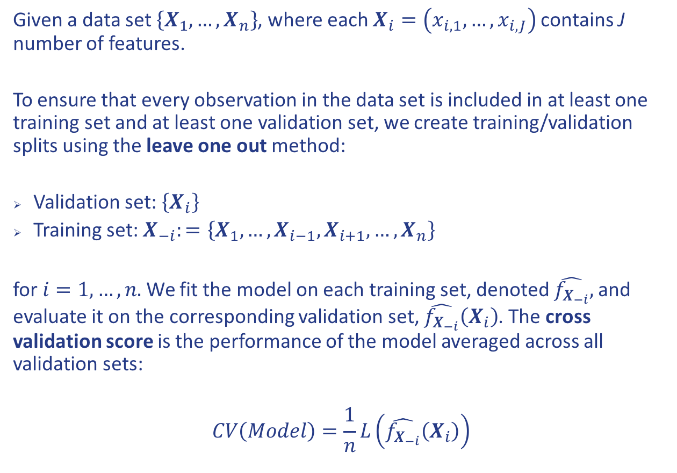
Cross validation: leave-one-out
Given a data set $\left\{X_{1},…,X_{n}\right\}$, where each $X_{i}=\left(x_{i,1},…,x_{i,J}\right)$ contains J number of features.
To ensure that every observation in the data set is included in at least one training set and at least one validation set, we create training/validation splits using the leave one out method:
Validation set: $\left\{X_{i}\right\}$
Training set: $X_{−i}:=\left\{X_{1},…,X_{i−1},X_{i+1},…,X_{n}\right\}$
for $i=1,…,n.$ We fit the model on each training set, denoted $\hat{f_{X_{−i}}},$ and evaluate it on the corresponding validation set, $\hat{f_{X_{−i}}}\left(X_{i}\right)$. The cross validation score is the performance of the model averaged across all validation sets:
$$CV\left(Model\right)=\frac{1}{n}L\left(\hat{f_{X_{−i}}}\left(X_{i}\right)\right)$$

Slide 22
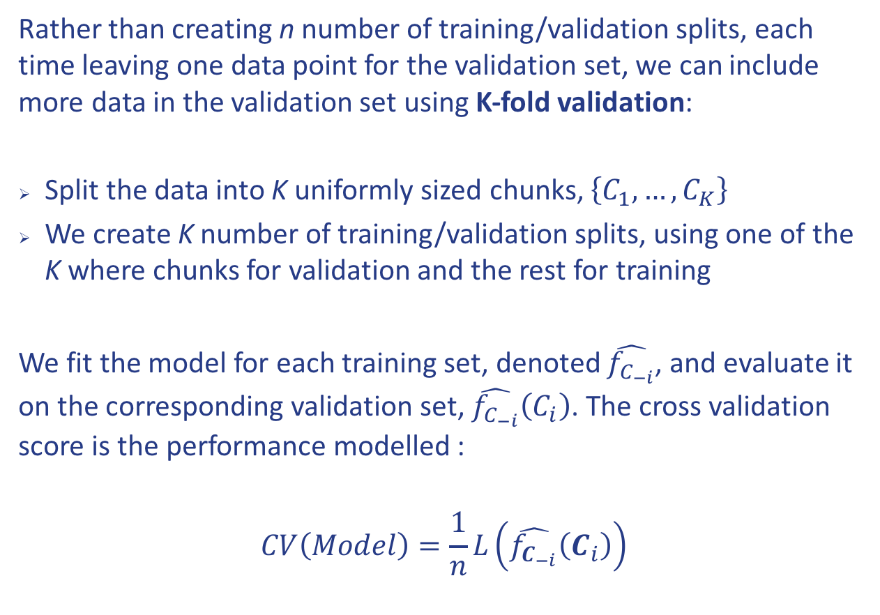
Cross validation: K-fold
Rather than creating n number of training/validation splits, each time leaving one data point for the validation set, we can include more data in the validation set using K-fold validation:
Split the data into K uniformly sized chunks, $\left\{C_{1},…,C_{K}\right\}$
We create K number of training/validation splits, using one of the K where chunks for validation and the rest for training
We fit the model for each training set, denoted $\hat{f_{C_{−i}}}$, and evaluate it on the corresponding validation set, $\hat{f_{C_{−i}}}\left(C_{i}\right)$. The cross validation score is the performance modelled :
$$CV\left(Model\right)=\frac{1}{n}L\left(\hat{f_{C_{−i}}}\left(C_{i}\right)\right)$$

Slide 23
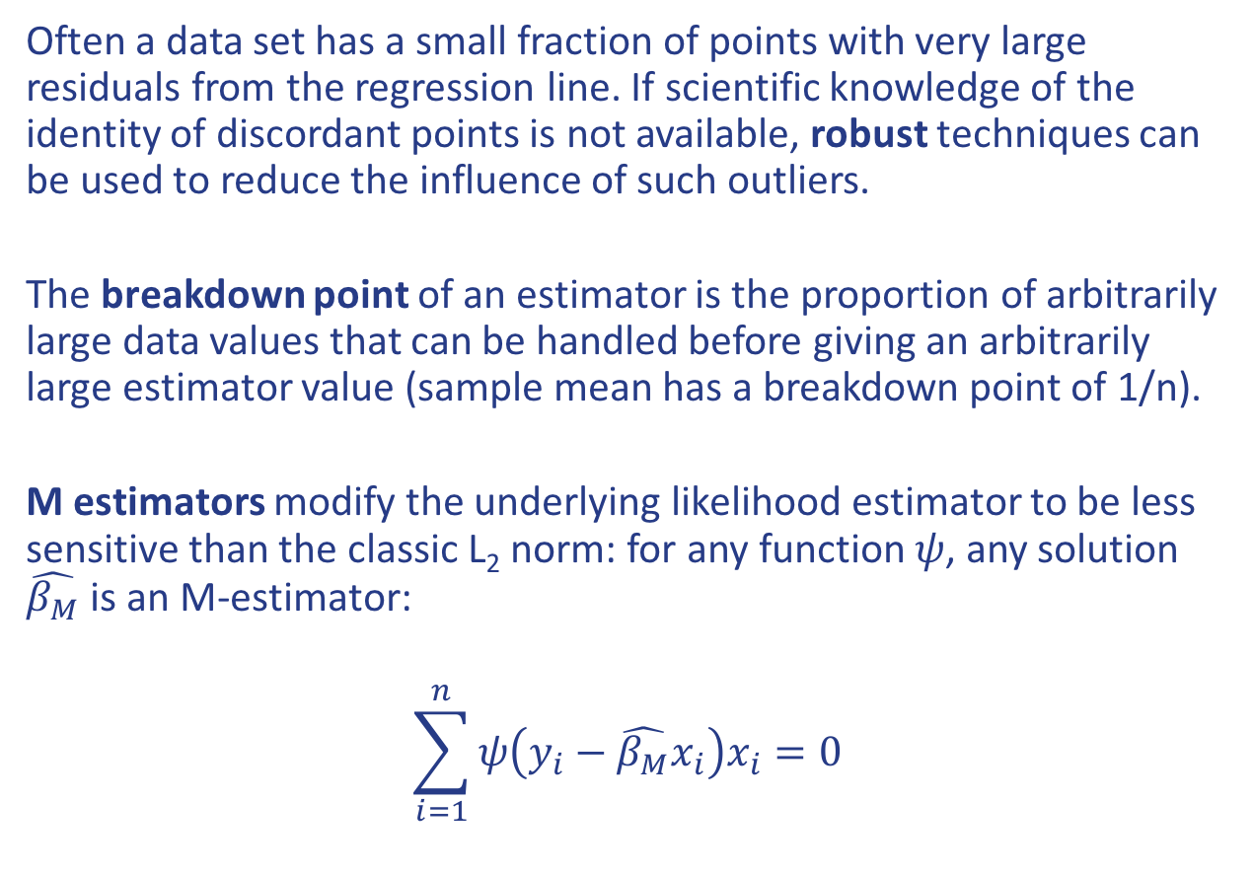
Robust regression
Often a data set has a small fraction of points with very large residuals from the regression line. If scientific knowledge of the identity of discordant points is not available, robust techniques can be used to reduce the influence of such outliers.
The breakdown point of an estimator is the proportion of arbitrarily large data values that can be handled before giving an arbitrarily large estimator value (sample mean has a breakdown point of 1/n).
M estimators modify the underlying likelihood estimator to be less sensitive than the classic L₂ norm: for any function 𝜓, any solution $\hat{β_{M}}$ is an M-estimator:
$$\sum_{i=1}^{n}{ψ\left(y_{i}−\hat{β_{M}}x_{i}\right)x_{i}=0}$$

Slide 24
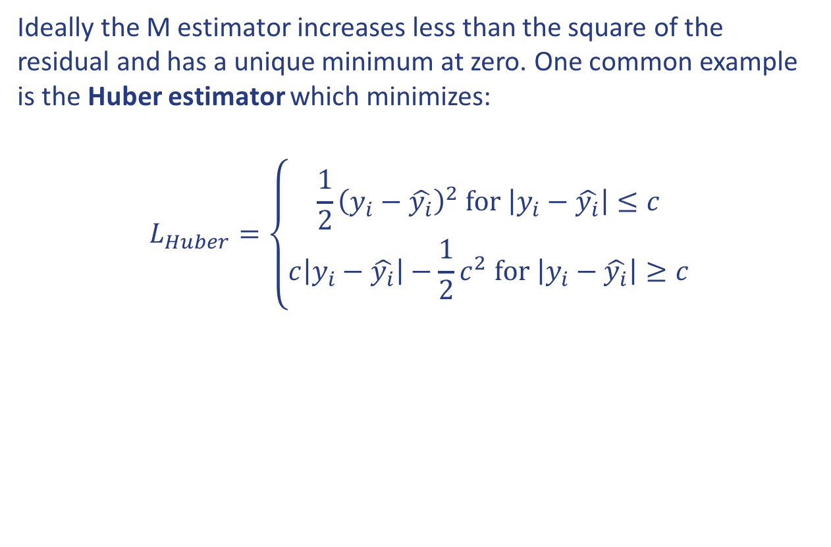
Robust regression: Huber loss
Ideally the M estimator increases less than the square of the residual and has a unique minimum at zero. One common example is the Huber estimator which minimizes:
$$L_{Huber}=\left\{\begin{aligned}\frac{1}{2}{\left(y_{i}−\hat{y_{i}}\right)}^{2} for \left|y_{i}−\hat{y_{i}}\right|≤c \\ c\left|y_{i}−\hat{y_{i}}\right|−\frac{1}{2}c^{2} for \left|y_{i}−\hat{y_{i}}\right|≥c\end{aligned}\right.$$
Ivezic et al. 2014

Slide 25
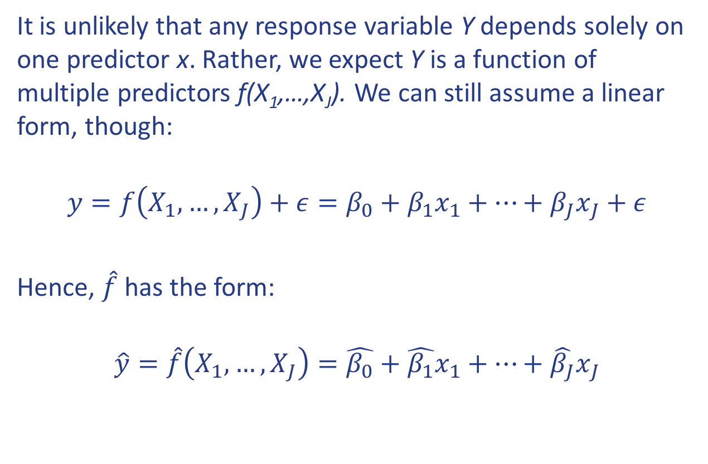
Multiple linear regression
It is unlikely that any response variable Y depends solely on one predictor x. Rather, we expect Y is a function of multiple predictors f(X₁,…,X_{J}). We can still assume a linear form, though:
$$y=f\left(X_{1},…,X_{J}\right)+ε=β_{0}+β_{1}x_{1}+…+β_{J}x_{J}+ε$$
Hence, $\hat{f}$ has the form:
$$\hat{y}=\hat{f}\left(X_{1},…,X_{J}\right)=\hat{β_{0}}+\hat{β_{1}}x_{1}+…+\hat{β_{J}}x_{J}$$

Slide 26
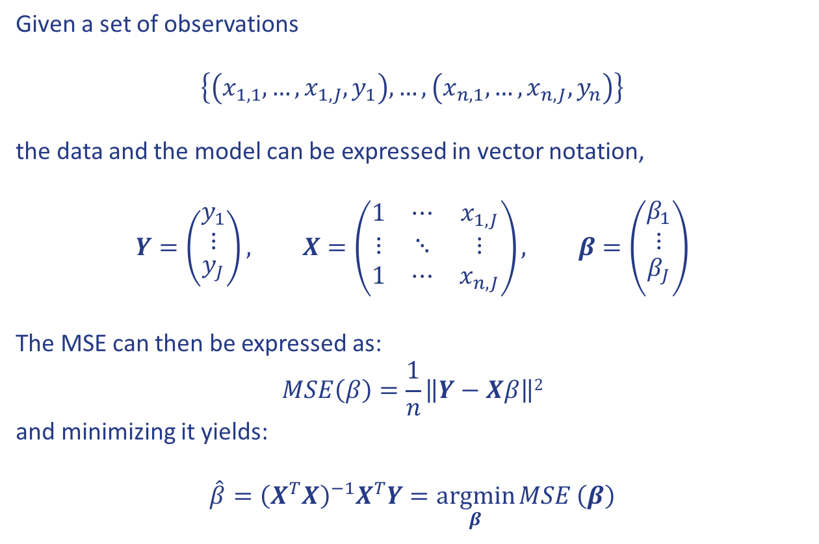
Multiple linear regression in vectors
Given a set of observations
$$\left\{\left(x_{1,1},…,x_{1,J},y_{1}\right),…,\left(x_{n,1},…,x_{n,J},y_{n}\right)\right\}$$
the data and the model can be expressed in vector notation,
$$Y=\left({\begin{aligned}y_{1} \\ ⋮\end{aligned} \atop y_{J}}\right), X=\left(\begin{matrix}1 & ⋯ & x_{1,J} \\ ⋮ & ⋱ & ⋮ \\ 1 & ⋯ & x_{n,J}\end{matrix}\right), β=\left({\begin{aligned}β_{1} \\ ⋮\end{aligned} \atop β_{J}}\right)$$
The MSE can then be expressed as:
$$MSE\left(β\right)=\frac{1}{n}\left\|Y−Xβ\right\|2$$
and minimizing it yields:
$$\hat{β}={\left(X^{T}X\right)}^{−1}X^{T}Y=\underset{β}{argmin}{MSE}\left(β\right)$$

Slide 27
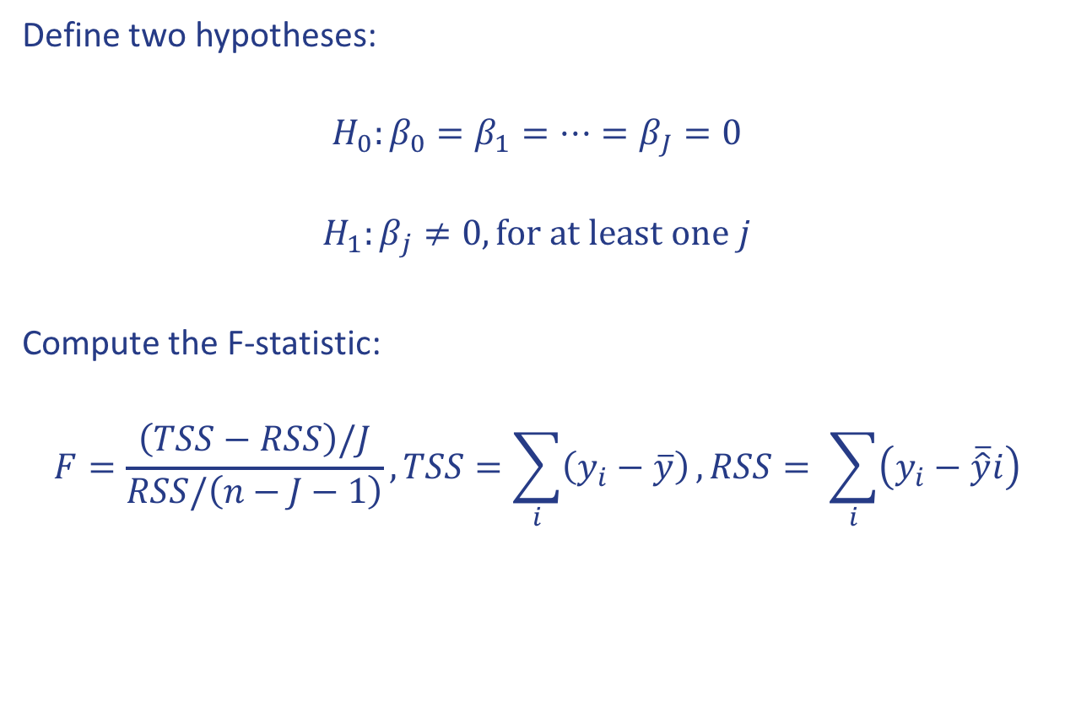
Is there a relationship between the response and the predictors?
Define two hypotheses:
$$H_{0}:β_{0}=β_{1}=…=β_{J}=0$$
$$H_{1}:β_{j}≠0, for at least one j$$
Compute the F-statistic:
$$F=\frac{\left(TSS−RSS\right)/J}{RSS/\left(n−J−1\right)},TSS=\sum_{i}{\left(y_{i}−\overline{y}\right)}, RSS= \sum_{i}{\left(y_{i}−\overline{\hat{y}}i\right)}$$

Slide 28
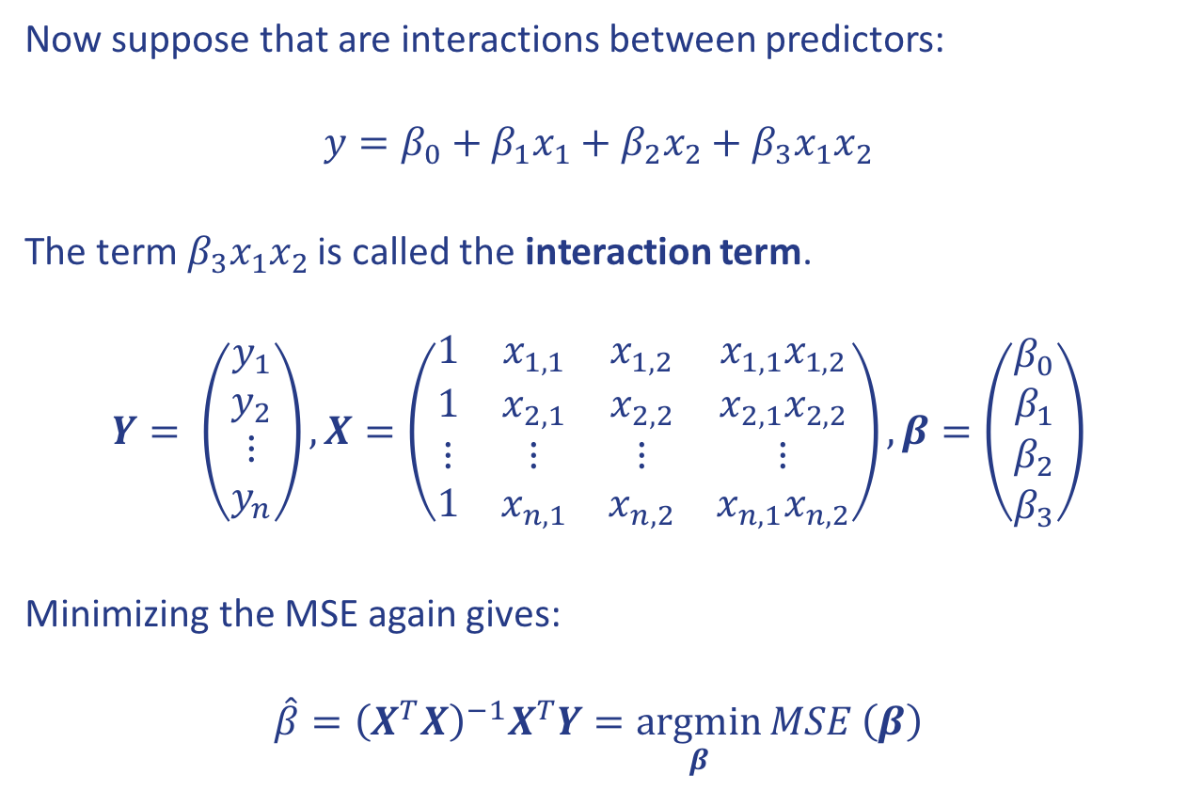
Interaction terms
Now suppose that are interactions between predictors:
$$y=β_{0}+β_{1}x_{1}+β_{2}x_{2}+β_{3}x_{1}x_{2}$$
The term$β_{3}x_{1}x_{2}$ is called the interaction term.
$$Y= \left(\begin{matrix}y_{1} \\ y_{2} \\ ⋮ \\ y_{n}\end{matrix}\right), X=\left(\begin{matrix}1 & x_{1,1} & x_{1,2} & {x_{1,1}x}_{1,2} \\ 1 & x_{2,1} & x_{2,2} & x_{2,1}x_{2,2} \\ ⋮ & ⋮ & ⋮ & ⋮ \\ 1 & x_{n,1} & x_{n,2} & x_{n,1}x_{n,2}\end{matrix}\right), β=\left(\begin{matrix}β_{0} \\ β_{1} \\ β_{2} \\ β_{3}\end{matrix}\right)$$
Minimizing the MSE again gives:
$$\hat{β}={\left(X^{T}X\right)}^{−1}X^{T}Y=\underset{β}{argmin}{MSE}\left(β\right)$$

Slide 29
Model selection
This is application of a principled method to determine the complexity of a model:
Choosing a subset of predictors
Choosing the degree of a polynomial model
It typically consists of the following steps:
Split the training set into two subsets: training and validation
Multiple models are fitted on the training set and each model is evaulated on the validation set
The model with the best validation performance is selected
The selected model is evaluated one last time on the testing set

Slide 30
Overfitting
Definition
Overfitting is the phenomenon wherein the model is unnecessarily complex. Portions of the model are actually capturing the random noise in the observation rather than the relationship between predictor(s) and response. This causes the model to lose predictive power with new data.
Overfitting can happen when:
There are too many predictors:
The feature space has high dimensionality
The polynomial degree is too high
Too many cross terms are considered
The coefficient values are too extreme
A sign of overfitting may be a high training R² or low MSE and unexpectedly poor testing performance.

Slide 31
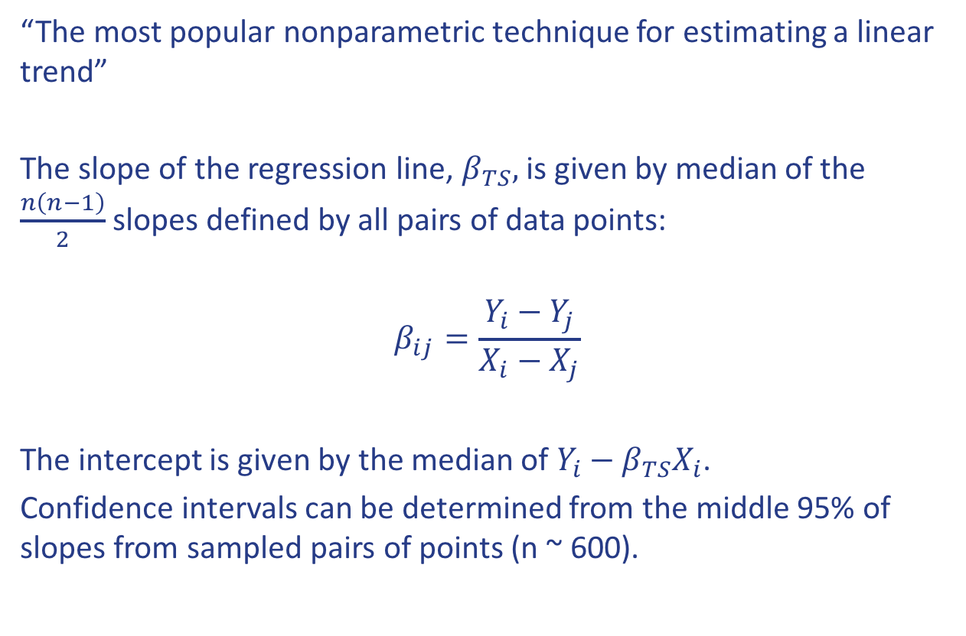
Theil-Sen estimator
“The most popular nonparametric technique for estimating a linear trend”
The slope of the regression line, $β_{TS},$ is given by median of the $\frac{n\left(n−1\right)}{2}$ slopes defined by all pairs of data points:
$$β_{ij}=\frac{Y_{i}−Y_{j}}{X_{i}−X_{j}}$$
The intercept is given by the median of $Y_{i}−β_{TS}X_{i}$.
Confidence intervals can be determined from the middle 95% of slopes from sampled pairs of points (n ~ 600).

Slide 32
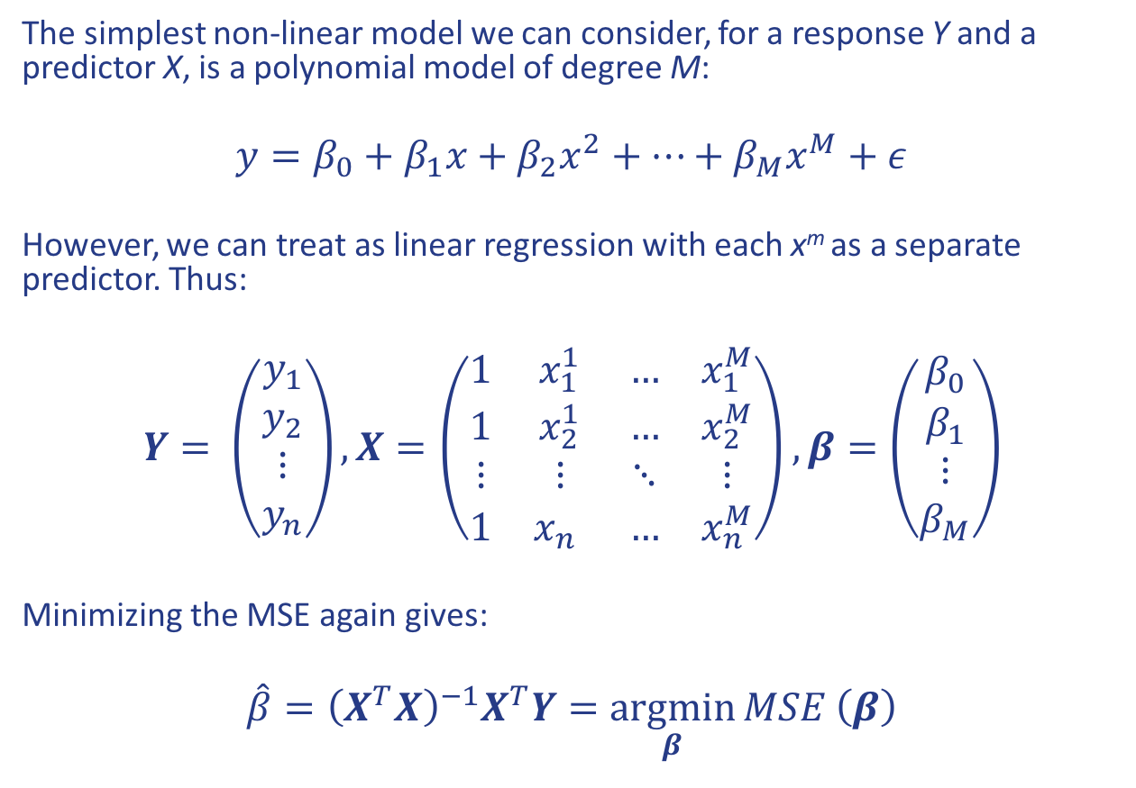
Polynomial regression
The simplest non-linear model we can consider, for a response Y and a predictor X, is a polynomial model of degree M:
$$y=β_{0}+β_{1}x+β_{2}x^{2}+…+β_{M}x^{M}+ε$$
However, we can treat as linear regression with each x^{m} as a separate predictor. Thus:
$$Y= \left(\begin{matrix}y_{1} \\ y_{2} \\ ⋮ \\ y_{n}\end{matrix}\right), X=\left(\begin{matrix}1 & x_{1}^{1} & … & x_{1}^{M} \\ 1 & x_{2}^{1} & … & x_{2}^{M} \\ ⋮ & ⋮ & ⋱ & ⋮ \\ 1 & x_{n}^{} & … & x_{n}^{M}\end{matrix}\right), β=\left(\begin{matrix}β_{0} \\ β_{1} \\ ⋮ \\ β_{M}\end{matrix}\right)$$
Minimizing the MSE again gives:
$$\hat{β}={\left(X^{T}X\right)}^{−1}X^{T}Y=\underset{β}{argmin}{MSE}\left(β\right)$$

Slide 33
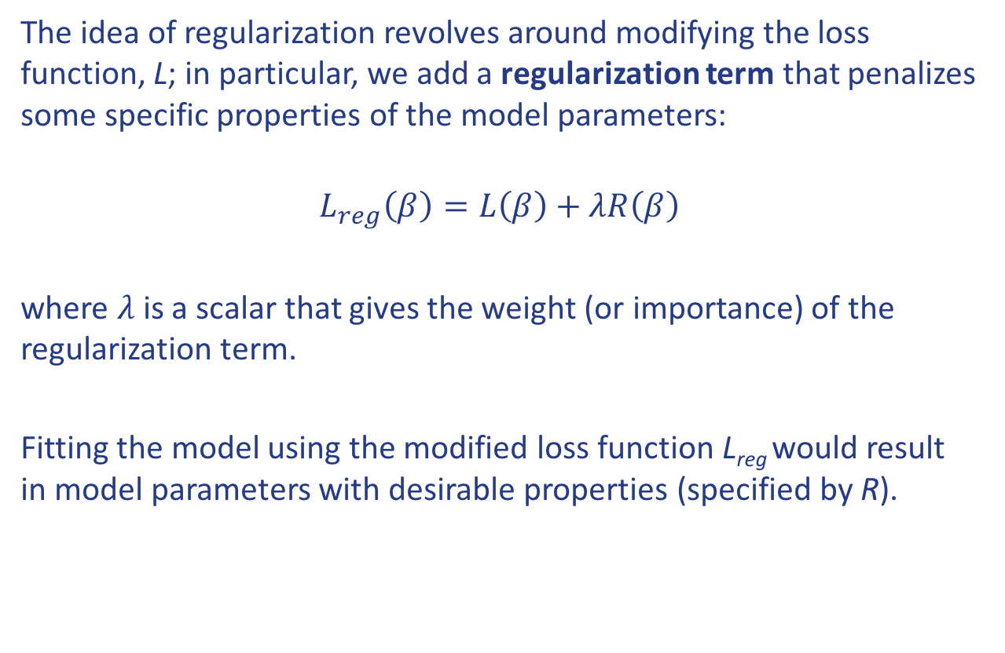
Regularization
The idea of regularization revolves around modifying the loss function, L; in particular, we add a regularization term that penalizes some specific properties of the model parameters:
$$L_{reg}\left(β\right)=L\left(β\right)+λR\left(β\right)$$
where 𝜆 is a scalar that gives the weight (or importance) of the regularization term.
Fitting the model using the modified loss function L_{reg} would result in model parameters with desirable properties (specified by R).

Slide 34
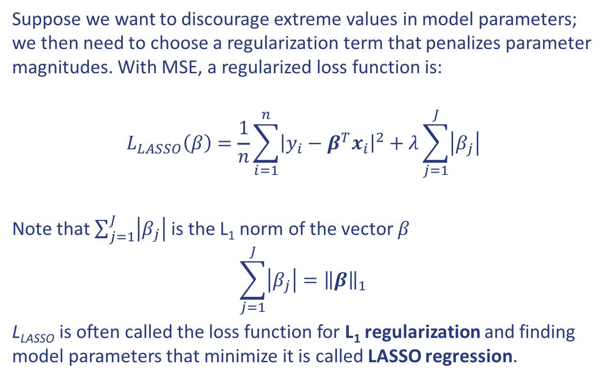
LASSO Regression
Suppose we want to discourage extreme values in model parameters; we then need to choose a regularization term that penalizes parameter magnitudes. With MSE, a regularized loss function is:
$$L_{LASSO}\left(β\right)=\frac{1}{n}\sum_{i=1}^{n}{{\left|y_{i}−β^{T}x_{i}\right|}^{2}}+λ\sum_{j=1}^{J}{\left|β_{j}\right|}$$
Note that $\sum_{j=1}^{J}{\left|β_{j}\right|}$ is the L₁ norm of the vector 𝛽
$$\sum_{j=1}^{J}{\left|β_{j}\right|={\left\|β\right\|}_{1}}$$
L_{LASSO} is often called the loss function for L₁ regularization and finding model parameters that minimize it is called LASSO regression.

Slide 35
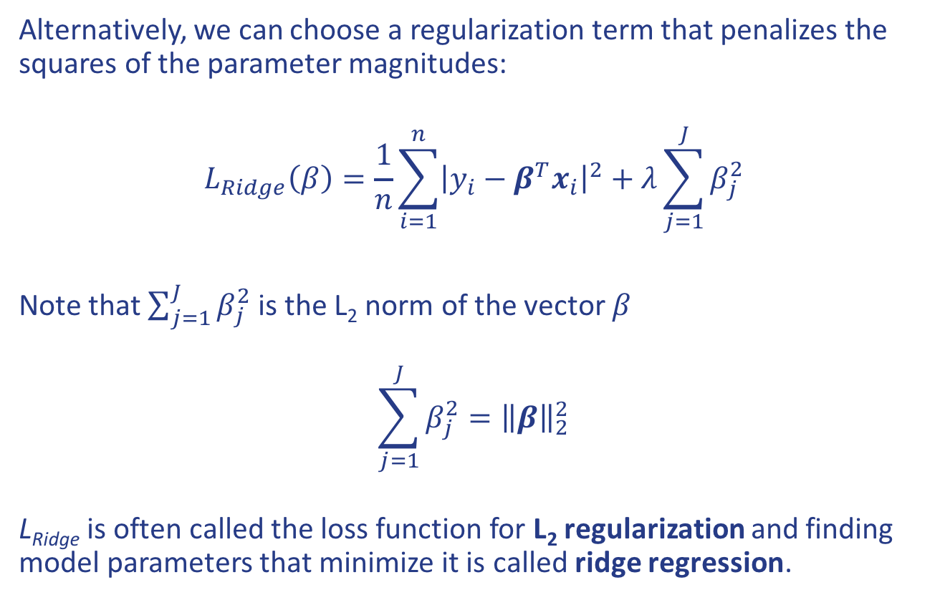
Ridge Regression
Alternatively, we can choose a regularization term that penalizes the squares of the parameter magnitudes:
$$L_{Ridge}\left(β\right)=\frac{1}{n}\sum_{i=1}^{n}{{\left|y_{i}−β^{T}x_{i}\right|}^{2}}+λ\sum_{j=1}^{J}{β_{j}^{2}}$$
Note that $\sum_{j=1}^{J}{β_{j}^{2}}$ is the L₂ norm of the vector 𝛽
$$\sum_{j=1}^{J}{β_{j}^{2}={\left\|β\right\|}_{2}^{2}}$$
L_{Ridge} is often called the loss function for L₂ regularization and finding model parameters that minimize it is called ridge regression.

Slide 36
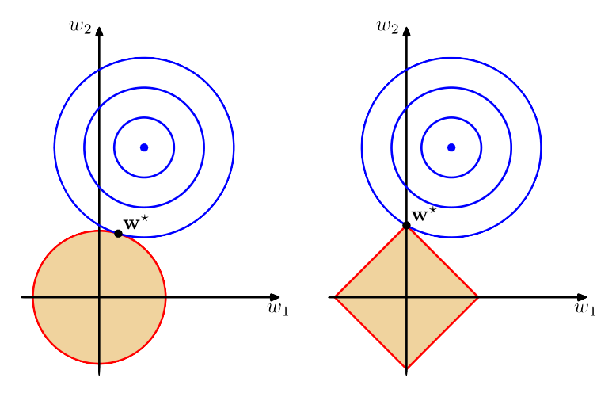
The geometry of regularization
Notes:
Geometric interpretation: left is LASSO, right is ridge. Circles are posterior distribution for no prior or regularization. The solid lines are constraints due to regularization. The corners of the L1 regularization create more opportunities for the sloution to have zeroes for some weights.

Slide 37
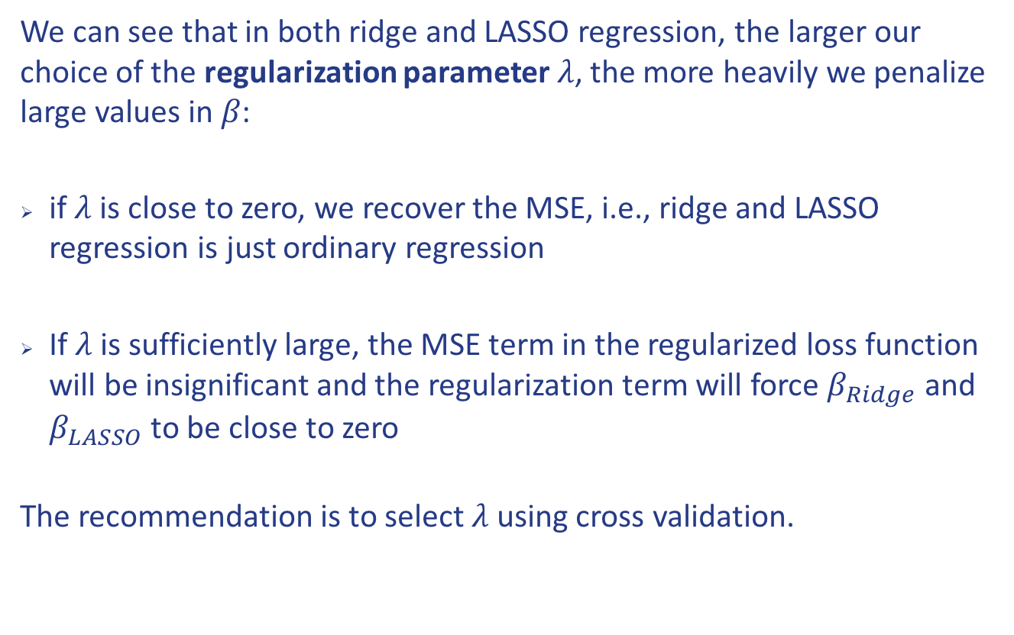
Choosing 𝜆
We can see that in both ridge and LASSO regression, the larger our choice of the regularization parameter 𝜆, the more heavily we penalize large values in 𝛽:
if 𝜆 is close to zero, we recover the MSE, i.e., ridge and LASSO regression is just ordinary regression
If 𝜆 is sufficiently large, the MSE term in the regularized loss function will be insignificant and the regularization term will force $β_{Ridge}$ and $β_{LASSO}$ to be close to zero
The recommendation is to select 𝜆 using cross validation.

Slide 38
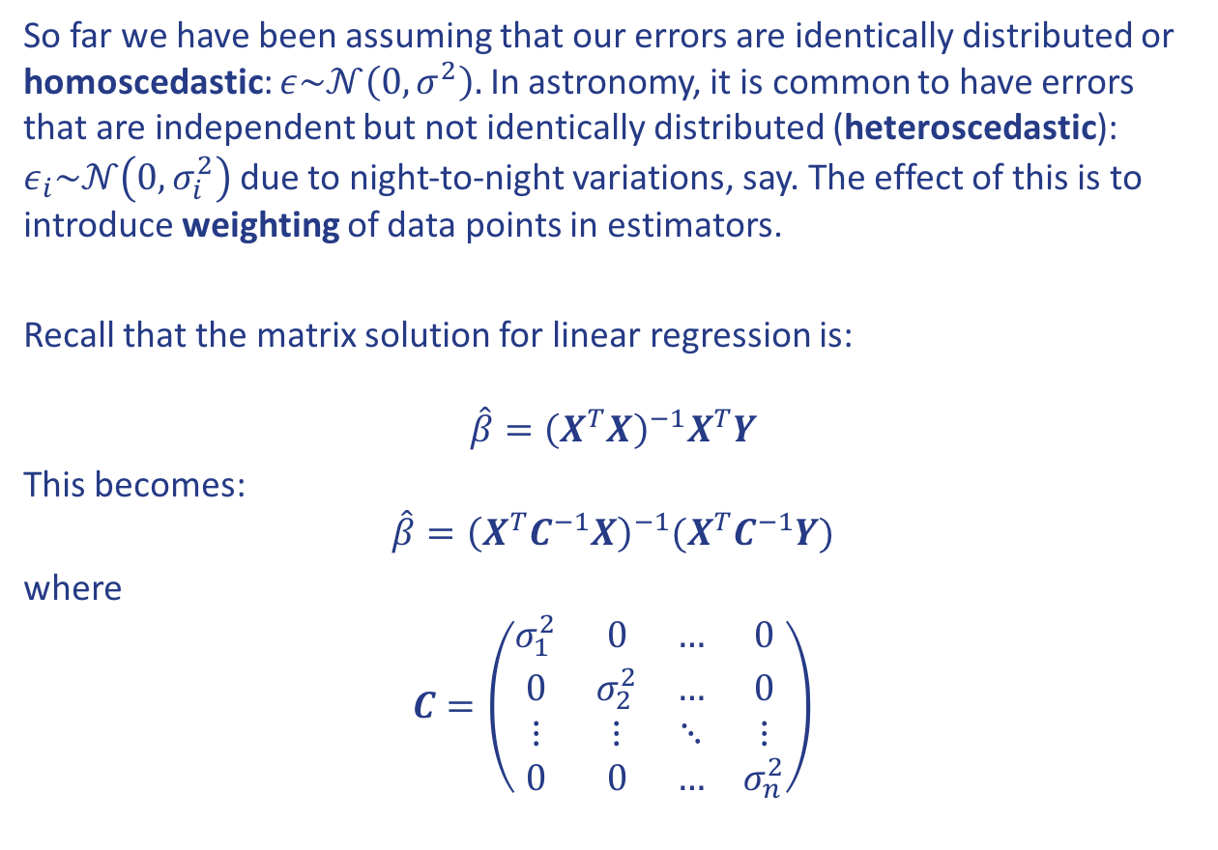
Heteroscedastic errors
So far we have been assuming that our errors are identically distributed or homoscedastic: $ε\sim 𝒩\left(0,σ^{2}\right).$ In astronomy, it is common to have errors that are independent but not identically distributed (heteroscedastic): $ε_{i}\sim 𝒩\left(0,σ_{i}^{2}\right)$ due to night-to-night variations, say. The effect of this is to introduce weighting of data points in estimators.
Recall that the matrix solution for linear regression is:
$$\hat{β}={\left(X^{T}X\right)}^{−1}X^{T}Y$$
This becomes:
$$\hat{β}={\left(X^{T}C^{−1}X\right)}^{−1}{(X}^{T}C^{−1}Y)$$
where
$$C=\left(\begin{matrix}σ_{1}^{2} & 0 & … & 0 \\ 0 & σ_{2}^{2} & … & 0 \\ ⋮ & ⋮ & ⋱ & ⋮ \\ 0 & 0 & … & σ_{n}^{2}\end{matrix}\right)$$

Slide 39
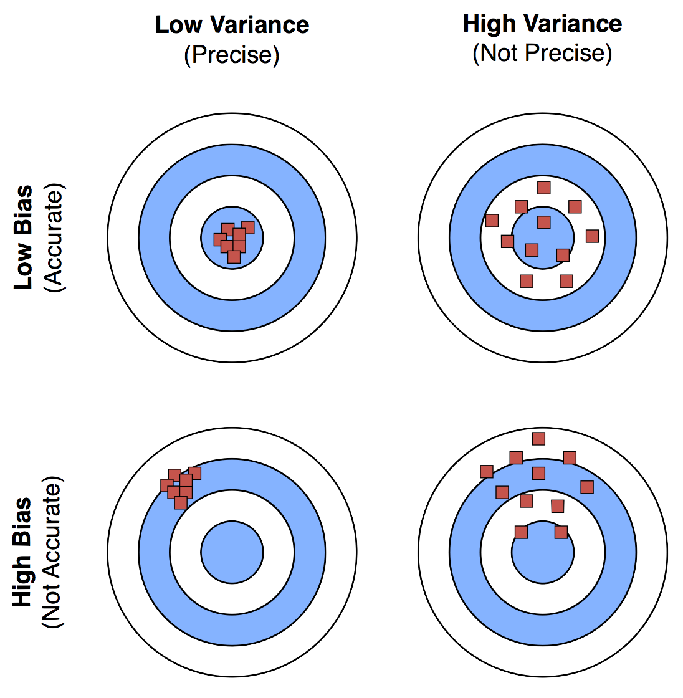
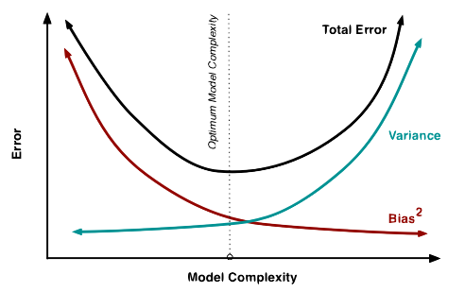
Bias and variance
Using a single validation set leaves open the possibility of overfitting

